Slide 1
Inline Function and Macros in C++ Md. Alamgir Hossain Senior Lecturer, Dept. of CSE Prime University Mail: alamgir.cse14.just@gmail.com

Slide 2

Macros
A macro is a piece of code in a program that is replaced by the value of the macro.
We can define the macro by using the #define directive. Whenever a compiler encounters the macro name, it replaces it with the definition of the macro.
There is no need to terminate the macro definition using a semi-colon (;).

Slide 3
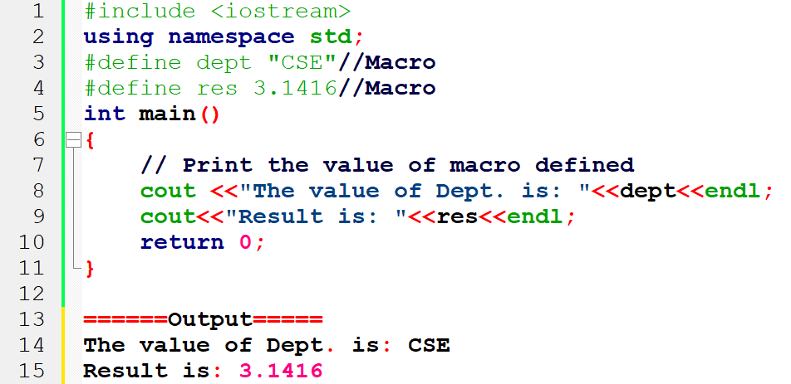
Macros

Slide 4
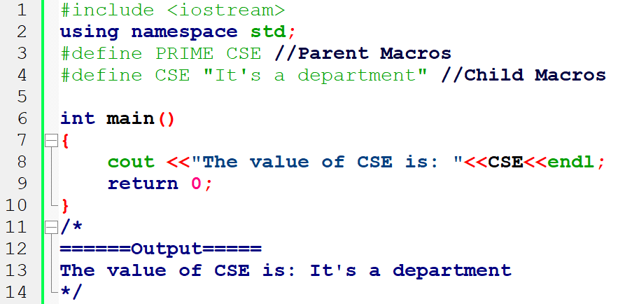
Types of Macros: Chain Macros
Chain macros are defined as the macros inside the macros. The parent macro is expanded in the first instance and then the child macro is expanded.

Slide 5
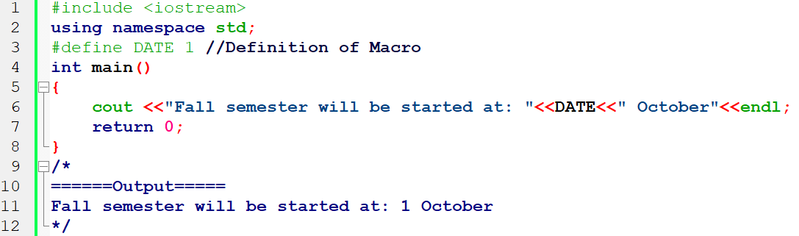
Types of Macros: Object-like Macros
An object-like macro is like an object in code that uses it. It is popularly used to replace a symbolic name with numerical/variable represented as a constant.

Slide 6
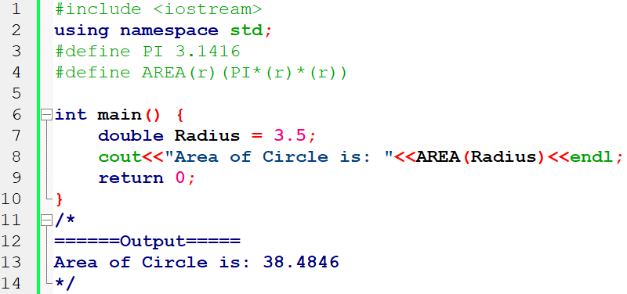
Types of Macros: Function-like Macros
Function-like macros work the same as the function call. It is used to replace the entire code instead of the function name.

Slide 7
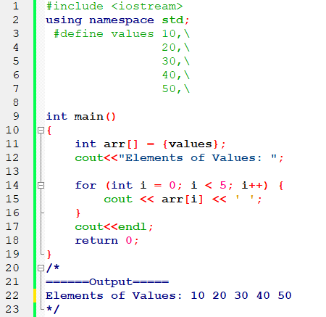
Types of Macros: Multi-line Macros
An object-line macro may be of multiple lines. Therefore, if we want to create a multi-line macro, we have to use the backslash-newline.

Slide 8
Types of Macros: Multi-line Macros
Speed versus size The main benefit of using macros is faster execution time. During preprocessing, a macro is expanded (replaced by its definition) inline each time it is used. A function definition occurs only once regardless of how many times it is called. Macros may increase code size but do not have the overhead associated with function calls.
Function evaluation A function evaluates to an address; a macro does not. Thus you cannot use a macro name in contexts requiring a pointer. For instance, you can declare a pointer to a function, but not a pointer to a macro.
Type-checking When you declare a function, the compiler can check the argument types. Because you cannot declare a macro, the compiler cannot check macro argument types; although it can check the number of arguments you pass to a macro.

Slide 9
Inline Function
Inline function is a function that is expanded in line when it is called.
When the inline function is called whole code of the inline function gets inserted or substituted at the point of inline function call.
This substitution is performed by the C++ compiler at compile time.

Slide 10
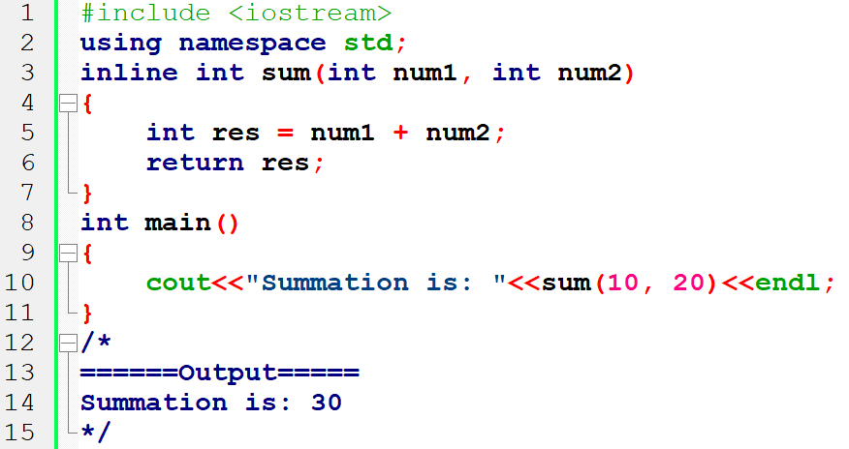
Inline Function

Slide 11
Circumstances when compiler not working
If a function contains a loop. (for, while, do-while)
If a function contains static variables.
If a function is recursive.
If a function return type is other than void, and the return statement doesn’t exist in function body.
If a function contains switch or goto statement.

Slide 12
Advantages of Inline Function
Function call overhead doesn’t occur.
It also saves the overhead of push/pop variables on the stack when function is called.
It also saves overhead of a return call from a function.
When you inline a function, you may enable compiler to perform context specific optimization on the body of function. Such optimizations are not possible for normal function calls. Other optimizations can be obtained by considering the flows of calling context and the called context.
Inline function may be useful (if it is small) for embedded systems because inline can yield less code than the function call preamble and return.

Slide 13
Good News about Inline Function in C++
All the functions defined inside the class are implicitly inline.
Inline function is best without using macros.

Slide 14
Thank You

